Slide 1


LUCIANO CONDE PERES
FEB 2024

Slide 2

Outline
Executive Summary
Introduction
Methodology
Results
Conclusion
Appendix

Slide 3
Executive Summary
The methodology applied in this project consists of using a data-driven approach, utilizing publicly available data gathered via REST APIs, leveraging machine learning techniques, interactive visual analytics with Folium and Plotly Dash in order to perform predictive analysis using classification models.
Summary of results
Falcon 9 obtained a success landing rate of 66.67%
ES-L1, GEO, HEO and SSO orbits present the highest success rate
Launch sites should be close to the coast as well as Equator line as much as possible
Payload mass is an important factor to determine the success of a launch, the range with highest success rate is between 3000 and 4000 kg
The 4 evaluated ML prediction methods perform similarly, with same accuracy score of 0.8333333333333334

Slide 4
Introduction
In the rapidly evolving landscape of commercial space exploration, the emergence of companies like SpaceX, Blue Origin, Virgin Galactic, and Rocket Lab has revolutionized the industry, making space travel more accessible than ever before. One of the key factors contributing to SpaceX's success is its ability to significantly reduce launch costs through the innovative reuse of the first stage of its Falcon 9 rockets.
The project objective is to delve into the dynamics of rocket launches, pricing strategies, and the critical question of whether SpaceX will reuse the first stage for each mission, offering Space Y a data-driven understanding of SpaceX's practices and, consequently, insights into optimizing their own launch operations for cost efficiency and competitiveness.

Slide 5

Section 1

Slide 6
Methodology
Executive Summary
Data collection methodology
Perform data wrangling
Perform exploratory data analysis (EDA) using visualization and SQL
Perform interactive visual analytics using Folium and Plotly Dash
Perform predictive analysis using classification models

Slide 7
Data Collection
Datasets were collected using:
SpaceX REST API via Python’s requests library, using the endpoint api.spacexdata.com/v4/launches/past – this API gives the information about the rocket used, payload delivered, launch specifications, landing specifications and landing outcome
Web scrapping using Python BeautifulSoup package to obtain some HTML tables from following Wikipedia website: https://en.wikipedia.org/w/index.php?title=List_of_Falcon_9_and_Falcon_Heavy_launches&oldid=1027686922. This site contains valuable Falcon 9 launch records.

Slide 8
Data Collection – SpaceX API
Import useful libraries, including requests
Request data from SpaceX API endpoint
SpaceX API calls notebook link
Dataset generated including only Falcon 9 launches data link
Request and parse SpaceX data to json format via GET request from API response
Save result into dataframe “data”
Get subset data from “data” using lauch IDs and store in lists
Create new dataframe “launch-dict” based on those lists
Data wrangling to deal with missing values
Filter “launch-dict” to include only Falcon 9 lauches
Export results to file dataset_part_1.csv

Slide 9
Data Collection - Scraping
Web scraping notebook reference link
Import useful libraries, including BeautifulSoup
Request Falcon 9 Wiki page via GET method
Create dataframe “df” parsing the lauch HTML tables
Extract all column/variable from HTML table header
Export to file spacex_web_scraped.csv

Slide 10
Data Wrangling
Exploratory Data Analysis of SpaceX dataset related to Falcon 9
Determine Training Labels for training supervised models
Convert landing outcomes into Training Labels:
1 -> successful
0 -> unsuccessful
Landing outcomes success rate calculated:
66.667%
Data wrangling notebook reference link
Load SpaceX dataset
“df” dataframe
Number launches on each site
Number occurrence each orbit
“bad_outcomes”
Set of bad outcomes based on “landing_outcomes”
Contains “none” or “false” values
“landing_outcomes”
Number landing outcomes on each site
“landing_class”
If record in “bad_outcomes”, set 0, otherwise set 1
Create “Class” column in “df”
based on “landing_class”
Success rate
Calculate mean for “Class”

Slide 11
EDA with Data Visualization
Exploratory Data Analysis and Feature Engineering using Pandas, Matplotlib and Seaborn
Main charts utilized in this step
Scatter plot – useful to view relationship between numerical and categorical variables, it was observed in our dataset:
Payload Mass vs Success Rate, FlightNumber vs LaunchSite, Launch sites vs. Payload Mass, FlightNumber vs. Orbit type, Payload Mass vs. Orbit type
Bar chart – good for representing an aggregate or statistical estimate for a numeric variable with the height/size of each rectangle
It was used to visualize the success rate of each orbit type
Line chart provides great visualizations for trend analysis
It was used to show the average launch success trend along the years
EDA with data visualization notebook reference link

Slide 12
EDA with SQL (1/2)
A connection was stablished to the database “my_data1.db”, than a table "SPACEXTBL" was created in order to have SpaceX dataset added from “Spacex.csv” file.
Using “sqlite3” to perform magic queries, several information was observed as follows:
Display the names of the unique launch sites in the space mission
Display 5 records where launch sites begin with the string 'CCA‘
Display the total payload mass carried by boosters launched by NASA (CRS)
Display average payload mass carried by booster version F9 v1.1
List the date when the first successful landing outcome in ground pad was achieved.

Slide 13
EDA with SQL (2/2)
List the names of the boosters which have success in drone ship and have payload mass greater than 4000 but less than 6000
List the total number of successful and failure mission outcomes
List the names of the “booster_versions” which have carried the maximum payload mass
List the records which will display the month names, failure “landing_outcomes” in drone ship, ”booster versions”, “launch_site” for the months in year 2015
Rank the count of landing outcomes (such as Failure (drone ship) or Success (ground pad)) between 2010-06-04 and 2017-03-20, in descending order
EDA with SQL notebook link

Slide 14
Build an Interactive Map with Folium
Objective to explore geographical patterns about launch sites
Map objects were added to folium map as follows:
Marker: identifies the launch sites in the map
Circle: to add a circle area with a text label in order to highlight a launch site based on its specific coordinate
Marker Cluster: since many launch records have the exact same coordinate, Marker clusters simplify the map containing many markers having the same coordinate.
Polyline: to illustrate in the map the calculated distances between a launch site to its proximities
Interactive map with Folium reference notebook link

Slide 15
Build a Dashboard with Plotly Dash
Objective to obtain insights to answer some questions, such as:
Which site has the largest successful launches
Which site has the highest launch success rate
Etc.
For this interactive dashboard, it was included following graphs:
Pie chart - displays which launch site has the largest success count (class=0 vs. class=1). Dropdown menu allows selection of different launch sites.
Scatter plot – displays payload correlation to mission outcome and identify some visual patterns. A slider allows to easily select different payload ranges.
Plotly Dash notebook link

Slide 16
Predictive Analysis (Classification)
Machine learning pipeline to predict if the first stage will land given the data from the preceding steps
ML models evaluated:
Logistic Regression
Support Vector Machine (SVM)
Classification Trees
K-Nearest Neighbors
Discover the method which performs best using test data
Predictive analysis notebook link
Load SpaceX dataset
“data” dataframe
Y variable -> Class column values
to_numpy()
X variable -> standardized data
preprocessing.StandardScaler()
Splited training and test data
X_train, X_test, Y_train, Y_test
test_size=0.2, random_state=2
train_test_split()
Best model selection based on highest score accuracy for test data
Logistic Regression (cv=10)
SVM (cv=10)
Determination of
best parameters
and accuracy
on the validation
data
Classification Trees (cv=10)
KNN (cv=10)

Slide 17
Results – Exploratory Data Analysis
It was observed from the dataset containing 90 records, a success landing rate of 66.67% for Falcon 9
Drop ship ASDS is the booster with highest number of successful landing outcomes: 41
The average payload mass carried by booster version F9 v1 is 2,928.4 kg
The first successful landing outcome in ground pad was achieved in Dec 22, 2015
4 launch sites where utilized in the space mission
CCAFS LC-40
VAFB SLC-4E
KSC LC-39A
CCAFS SLC-40

Slide 18
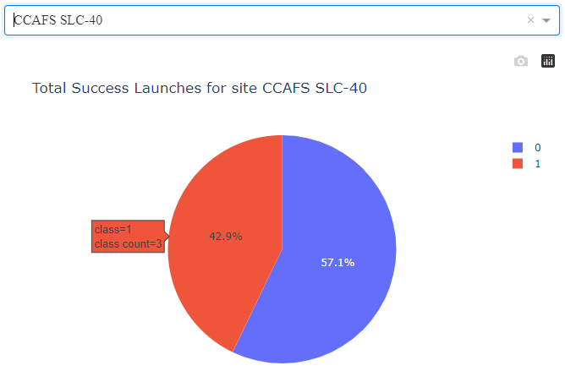
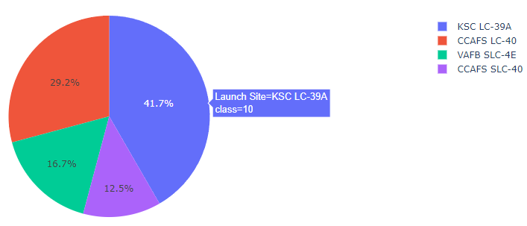
Results – Interactive Dashboard (1/3)
Site with largest number of successful launches:
KSC LC-39A with 10 occurrences
Site with highest launch success rate:
CCFAFS SLC-40 with 42,9%

Slide 19
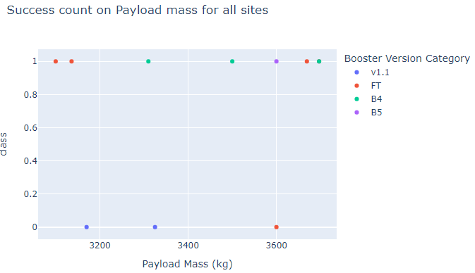
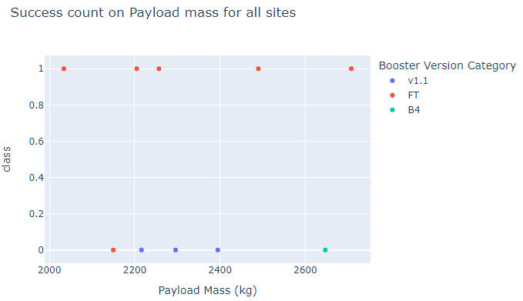
Results – Interactive Dashboard (2/3)
Payload range with highest launch success rate: 3000 – 4000 kg
Payload range with lowest launch success rate: 2000 – 3000 kg / 5000 – 6000kg

Slide 20
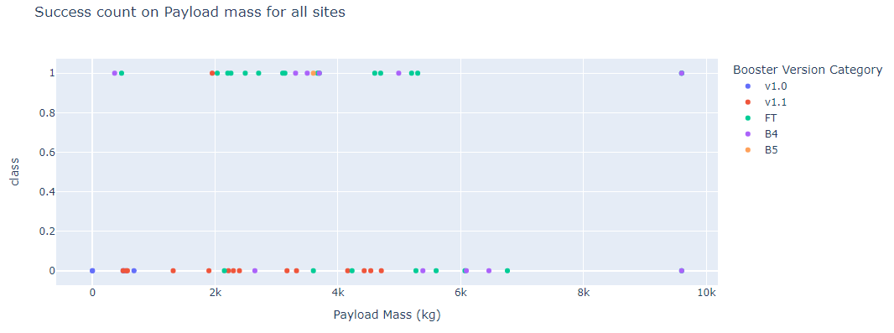
Results – Interactive Dashboard (3/3)
F9 Booster version with the highest launch success rate: FT

Slide 21
Results - Predictive analysis
Sample assessed contained 90 records, 83 columns (parameters)
All evaluated methods gave exact same accuracy score performance as follows:
Method | Best Hyperparameters | Accuracy (score method)
Logistic Regression | 'C': 0.01, 'penalty': 'l2', 'solver': 'lbfgs' | 0.8333333333333334
SVM | 'C': 1.0, 'gamma': 0.03162277660168379, 'kernel': 'sigmoid' | 0.8333333333333334
Classification Tree | 'criterion': 'entropy', 'max_depth': 6, 'max_features': 'auto', 'min_samples_leaf': 1, 'min_samples_split': 5, 'splitter': 'random' | 0.8333333333333334
KNN | 'algorithm': 'auto', 'n_neighbors': 10, 'p': 1 | 0.8333333333333334

Slide 22

Section 2

Slide 23
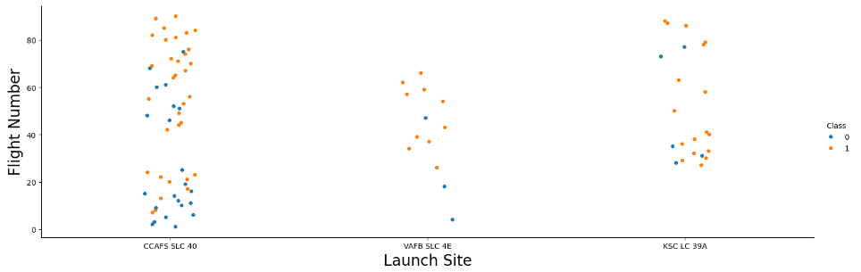
Flight Number vs. Launch Site
CCAFS SLC-40 has the largest number of launches
No correlation observed with Flight Number

Slide 24
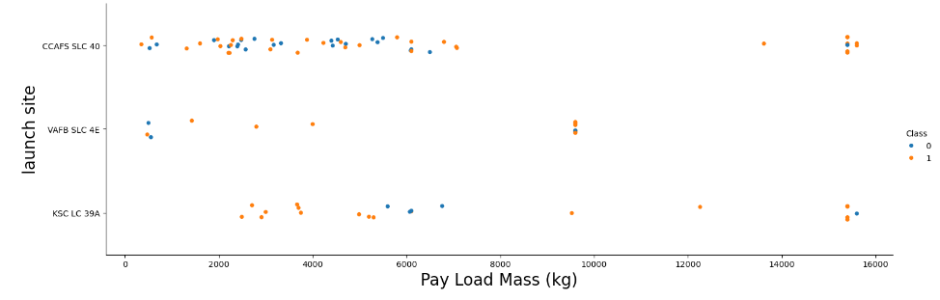
Payload vs. Launch Site
This chart reveals that lower payload mass has better success rate
There are no launches from VAFB-SLC heavy payload mass(>10,000).

Slide 25
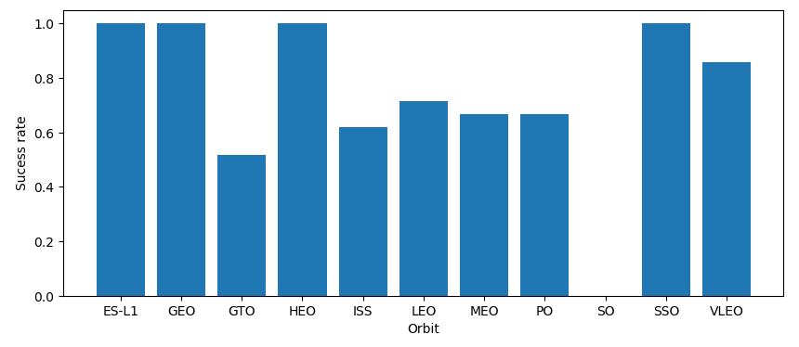
Success Rate vs. Orbit Type
ES-L1, GEO, HEO and SSO present the highest success rate

Slide 26
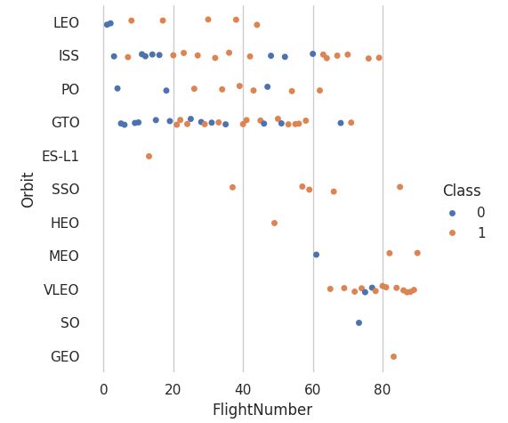
Flight Number vs. Orbit Type
Success appears related to the number of flights for LEO orbit
There seems to be no relationship between flight number when in GTO orbit

Slide 27
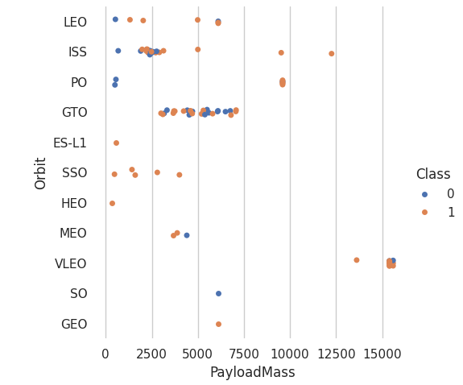
Payload vs. Orbit Type
Lower payload mass usually has better success rates

Slide 28
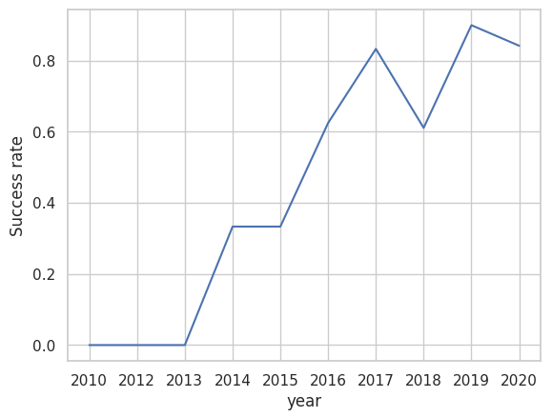
Launch Success Yearly Trend
This chart reveals that success rate since 2013 kept increasing till 2020
Highest success rate achieved in 2019

Slide 29
All Launch Site Names
Names of the unique launch sites obtained via SQL query:
select distinct Launch_Site from SPACEXTBL
CCAFS LC-40
VAFB SLC-4E
KSC LC-39A
CCAFS SLC-40

Slide 30
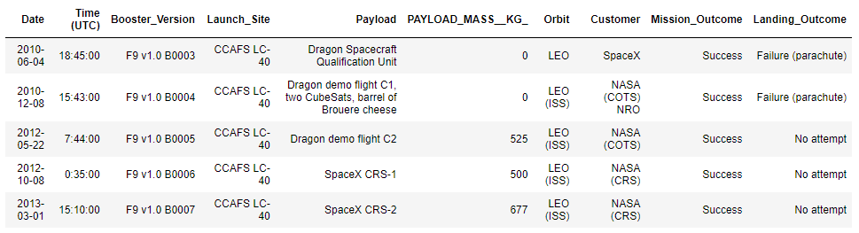
Launch Site Names Begin with 'CCA'
5 records where launch sites begin with `CCA` using SQL query:
select * from SPACEXTBL where Launch_Site like 'CCA%' limit 5

Slide 31
Total Payload Mass
Customer | Booster_Version | total payload mass
NASA (CRS) | F9 B4 B1039.2 | 2647
NASA (CRS) | F9 B4 B1039.1 | 3310
NASA (CRS) | F9 B4 B1045.2 | 2697
NASA (CRS) | F9 B5 B1056.2 | 2268
NASA (CRS) | F9 B5 B1058.4 | 2972
NASA (CRS) | F9 B5 B1059.2 | 1977
NASA (CRS) | F9 B5B1050 | 2500
NASA (CRS) | F9 B5B1056.1 | 2495
NASA (CRS) | F9 FT B1035.2 | 2205
NASA (CRS) | F9 FT B1021.1 | 3136
NASA (CRS) | F9 FT B1025.1 | 2257
NASA (CRS) | F9 FT B1031.1 | 2490
NASA (CRS) | F9 FT B1035.1 | 2708
NASA (CRS) | F9 v1.0 B0006 | 500
NASA (CRS) | F9 v1.0 B0007 | 677
NASA (CRS) | F9 v1.1 | 2296
NASA (CRS) | F9 v1.1 B1010 | 2216
NASA (CRS) | F9 v1.1 B1012 | 2395
NASA (CRS) | F9 v1.1 B1015 | 1898
NASA (CRS) | F9 v1.1 B1018 | 1952
Total payload carried by boosters from NASA obtained via SQL query:
select Customer, Booster_Version, sum(PAYLOAD_MASS__KG_) as 'total payload mass'
from SPACEXTBL
where Customer = 'NASA (CRS)'
group by Customer, Booster_Version

Slide 32
Average Payload Mass by F9 v1.1
Using below SQL query, it was obtained the average payload mass carried by booster version F9 v1.1 of 2,928,4 kg
select Booster_Version, avg(PAYLOAD_MASS__KG_) as ‘avg payload mass'
from SPACEXTBL
where Booster_Version = 'F9 v1.1'
group by Booster_Version

Slide 33
First Successful Ground Landing Date
Dec 22nd, 2015 was the date of the first successful landing outcome on ground pad was obtained via SQL query:
select *
from SPACEXTBL
where Landing_Outcome = 'Success (ground pad)'
order by Date asc limit 1

Slide 34
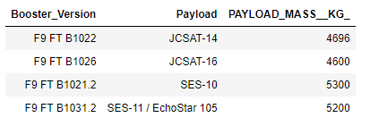
Successful Drone Ship Landing with Payload between 4000 and 6000
The names of boosters which have successfully landed on drone ship and had payload mass greater than 4000 but less than 6000 were obtained via SQL query:
select Booster_Version, Payload, PAYLOAD_MASS__KG_ from SPACEXTBL where (Landing_Outcome = 'Success (drone ship)') and (PAYLOAD_MASS__KG_ between 4000 and 6000)

Slide 35
Total Number of Successful and Failure Mission Outcomes
We observed a total number of 100 successful and only 1 failure mission outcomes, using below SQL query:
SELECT Mission_Outcome, count(Mission_Outcome) as Number_Mission_Outcomes
from SPACEXTBL
group by Mission_Outcome

Slide 36
Boosters Carried Maximum Payload
List of boosters which have carried the maximum payload mass was obtained via SQL, using subqueries as follows:
SELECT DISTINCT BOOSTER_VERSION
FROM SPACEXTBL WHERE PAYLOAD_MASS__KG_ = (SELECT MAX(PAYLOAD_MASS__KG_) FROM SPACEXTBL)
ORDER BY BOOSTER_VERSION
Booster_Version
F9 B5 B1048.4
F9 B5 B1048.5
F9 B5 B1049.4
F9 B5 B1049.5
F9 B5 B1049.7
F9 B5 B1051.3
F9 B5 B1051.4
F9 B5 B1051.6
F9 B5 B1056.4
F9 B5 B1058.3
F9 B5 B1060.2
F9 B5 B1060.3

Slide 37
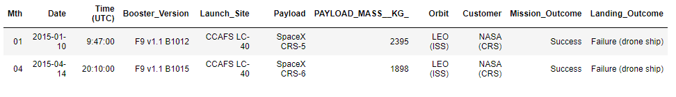
2015 Launch Records
List of failed landing_outcomes in drone ship, their booster versions, and launch site names for in year 2015. Since SQLLite does not support month names, it was used a formula for month and year as follows:
substr(Date, 6,2) as month to get the months
substr(Date,0,5)='2015' for year.
SQL query:
select substr(Date, 6,2) as Mth, *
from SPACEXTBL
where Landing_Outcome = 'Failure (drone ship)' and substr(Date,0,5)='2015'

Slide 38
Rank Landing Outcomes Between 2010-06-04 and 2017-03-20
Rank of landing outcomes between the date 2010-06-04 and 2017-03-20, in descending order, using below SQL query:
SELECT Landing_Outcome, count(*) as Qty
FROM SPACEXTBL
WHERE Date between '2010-06-04' AND '2017-03-20' GROUP BY "Landing_Outcome"
ORDER BY "Qty"
Landing_Outcome | Qty
Precluded (drone ship) | 1
Failure (parachute) | 2
Uncontrolled (ocean) | 2
Controlled (ocean) | 3
Success (ground pad) | 3
Failure (drone ship) | 5
Success (drone ship) | 5
No attempt | 10

Slide 39

Section 3

Slide 40
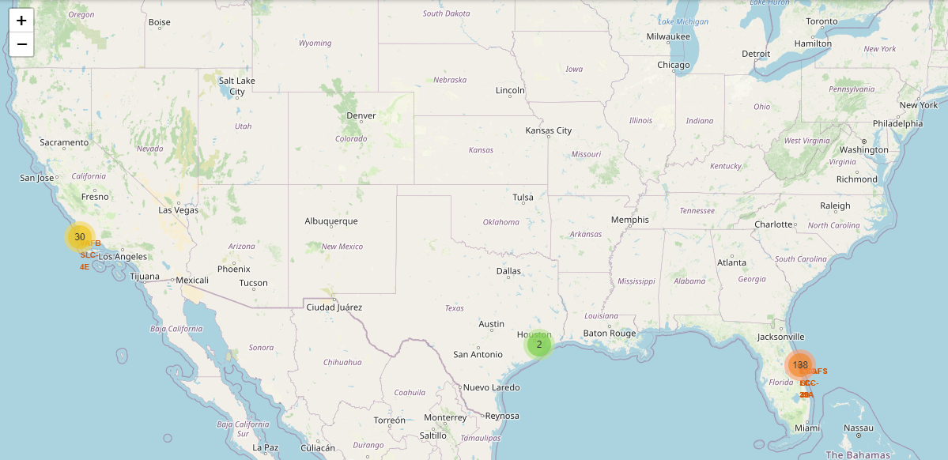
Launch Sites Visualization with Interactive Map
It observed that launch sites (marked in yellow and orange circles) are close to the coast as well as Equator line

Slide 41
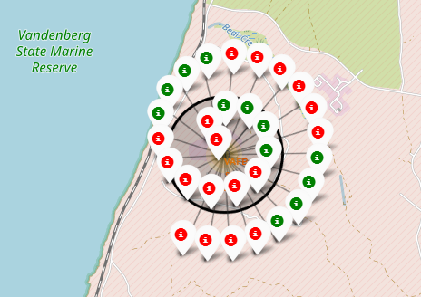
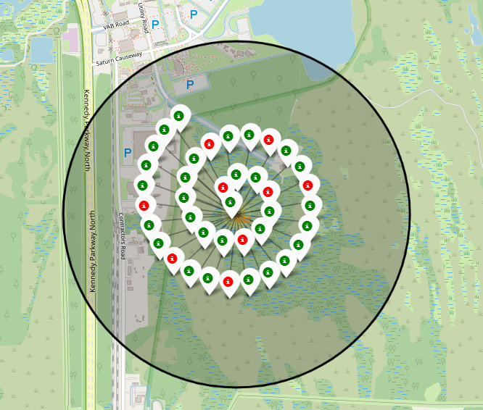
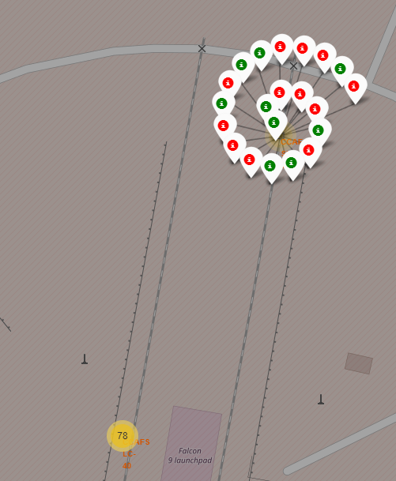
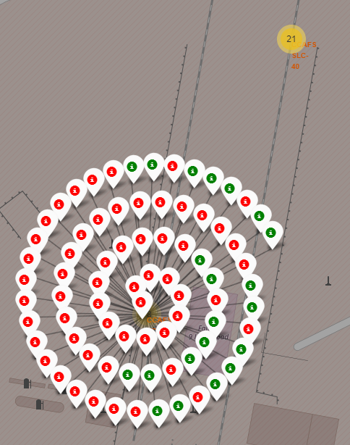
Successful & Failures Launches View with Interactive Map
Successful launches (class=1) are represented with a green marker and if failed ones, with a red marker (class=0)

Slide 42
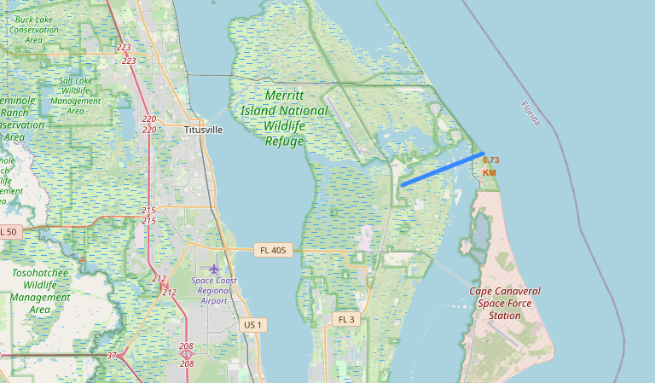
Distance Views with Interactive Map
Distances with points of interests can be calculated and easily visualized in the map
Below we see an example, the blue line shows the distance between the coast and launch site KSC LC-39A (6.73km)

Slide 43

Section 4

Slide 44
Number of Successful Launches
KSC LC-39A has the largest number of successful launches among the 4 sites

Slide 45
Launch Success Ratio
CCAFS SLC-40 is the site with highest success ratio, although it has only 3 successful launches, it is the site with lowest number of launches among the 4 ones

Slide 46
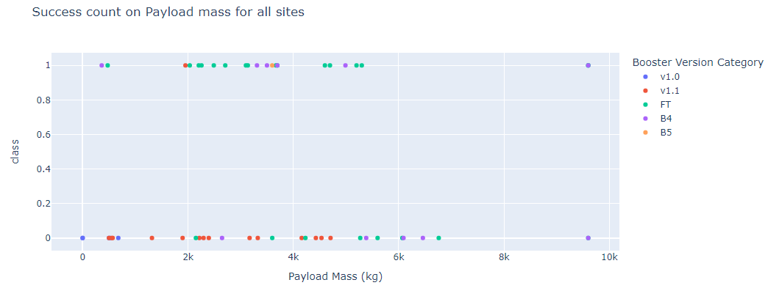
Payload vs. Launch Outcome
Payload mass is an important factor to determine the success of a launch
Payload range with highest launch success rate is 3000 – 4000 kg

Slide 47

Section 5

Slide 48
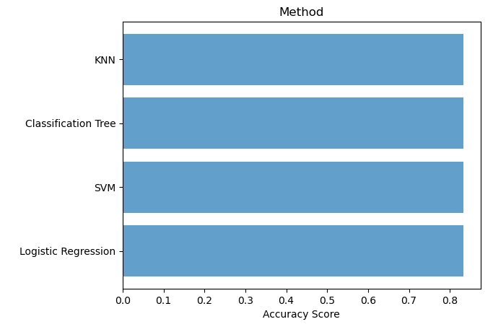
Classification Accuracy
All models have the same classification accuracy
Score of 0.8333333333333334

Slide 49
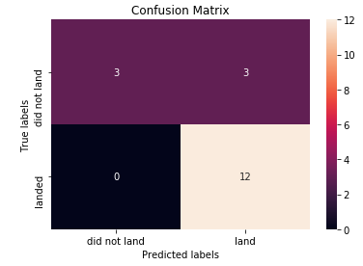
Confusion Matrix
Confusion matrixes are identical for all 4 evaluated methods since they perform similarly, with same accuracy
It was observed they can distinguish between the different classes
The major problem is related to false positives
Logistic Regression
SVM
Classification Tree
KNN

Slide 50
Conclusions
Falcon 9 obtained a success landing rate of 66.67%
ES-L1, GEO, HEO and SSO orbits present the highest success rate
Drop ship ASDS is the booster with highest number of successful landing outcomes: 41
Launch sites should be close to the coast as well as Equator line as much as possible
Payload mass is an important factor to determine the success of a launch, the range with highest success rate is between 3000 and 4000 kg
CCAFS SLC-40 is the site with highest success ratio (57.1%), although KSC LC-39A has the largest number of successful launches (41.7%)
The 4 evaluated ML prediction methods perform similarly, with same accuracy score of 0.8333333333333334
The major problem for all the ML methods is related to false positives

Slide 51


